Slide 1



You Don't Need a Centralized Verifier: Toward Scalable Data Plane Checking via Distributed, On-Device Verification
Qiao Xiang¹, Chenyang Huang¹, Ridi Wen¹, Yuxin Wang¹, Xiwen Fan¹,
Alan Liu², Linghe Kong³, Dennis Duan⁴, Franck Le⁵, Wei Sun⁶
¹Xiamen University, ²University of Maryland, ³Shanghai Jiao Tong University, ⁴Yale University, ⁵IBM T.J. Watson Research Center, ⁶UT Austin
June 2023, Hong Kong, China, ACM APNet'23

Slide 2
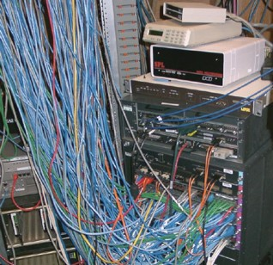
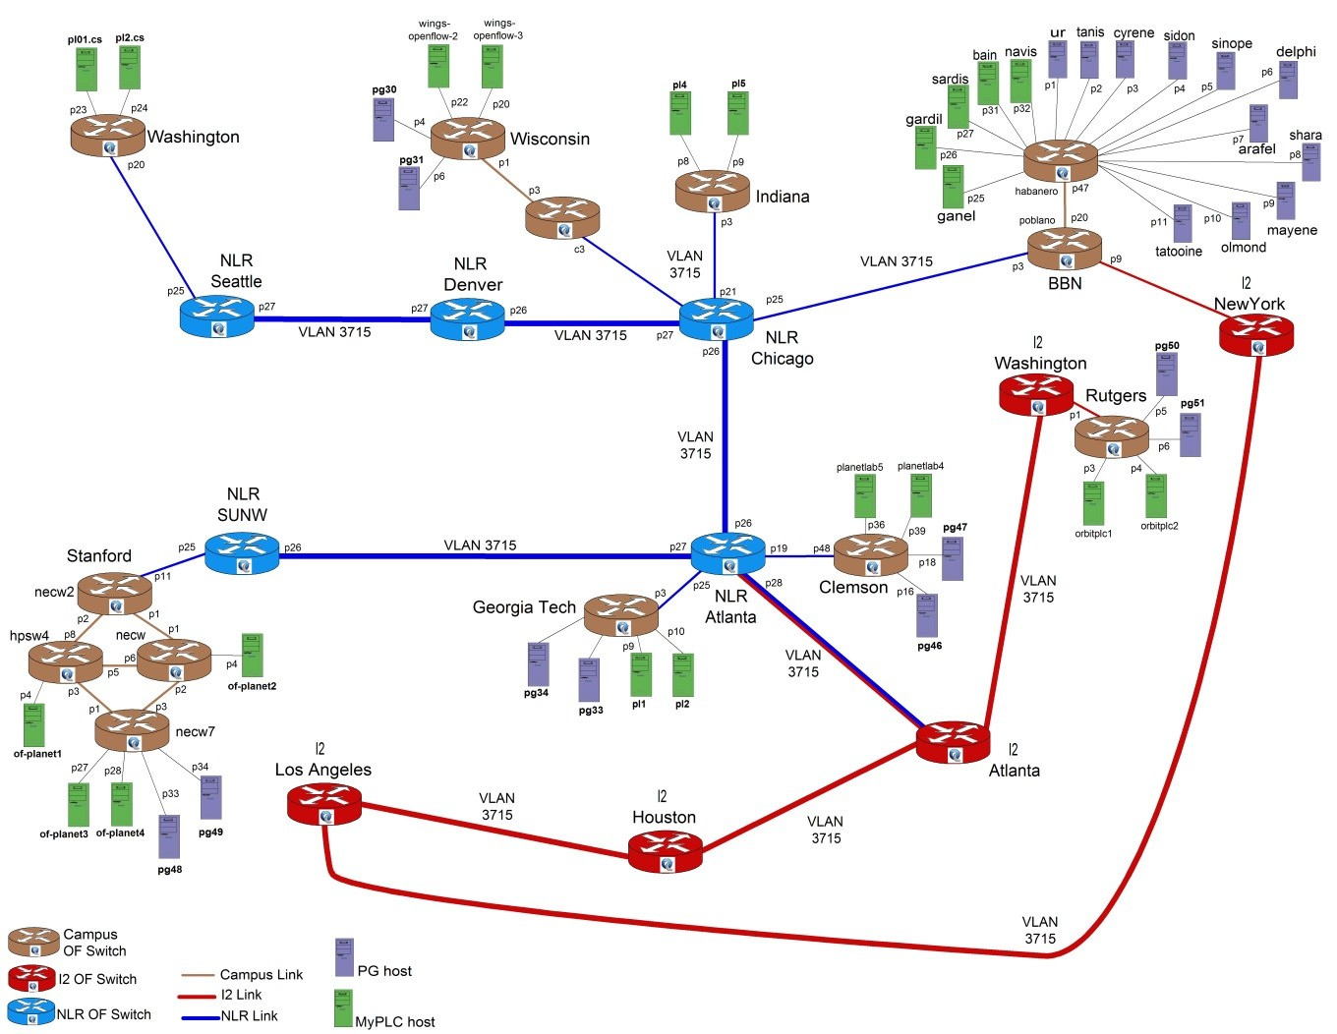

Background
Modern networks are
increasingly more complex
outages increasingly more costly
Source: http://groups.geni.net/geni/chrome/site/thumbnails/wiki/TangoGENI/OF-VLAN3715_1000.jpg

Slide 3
Network Verification: Powerful Tool to Check Network Forwarding Behavior
Control Plane
Data Plane
config
FIB
execute
config
FIB
FIB
config
Control plane verification
Batfish [NSDI'15]
Bagpipe [OOPSLA'16]
Minesweeper [SIGCOMM'17]
Bonsai [SIGCOMM'18]
Hoyan [SIGCOMM'21]
…
Data plane verification
HSA [NSDI'12]
Veriflow [NSDI'13]
Atomic Predicates [ICNP'13]
APKeep [NSDI'20]
Flash [SIGCOMM'22]
…
Notes:
Traditional operators don’t use verification
That may be changing with new tools like HSA, Veriflow
Still, there is simulation in the mix, because the control plane will be simulated

Slide 4
Why Study Data Plane Verification?
Data plane is the ground truth of actual forwarding behavior
Q: Why CP verification fails to catch this?
A: ACL/routing configurations pass control plane verification, but with a different input from the actual network

Slide 5
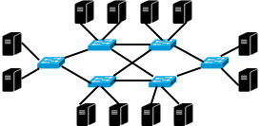
How Does DPV Usually Work?
A (cluster of) server(s) as a centralized verifier
Collect the data plane (e.g., FIB/ACL) from routers/switches through management network
Run computation-intensive, memory-intensive computation to verify the network data plane
Verifier
Management
Network
FIB/ACL
FIB/ACL
FIB/ACL
FIB/ACL

Slide 6
Issues of Centralized DPV
Need a highly-available management network
Incomplete DP, inconclusive result
Verifier becomes performance bottleneck
Larger network, more computation power
Verifier becomes single PoF
Verifier fails, no result
Out-of-band verification
Slow reaction to errors
Verifier
Management
Network
FIB/ACL
FIB/ACL
FIB/ACL
FIB/ACL

Slide 7
Our Proposal: Distributed, On-Device Verification
Basic idea: offload verification to distributed computations on network devices
Benefits:
Minimize the requirement of management network
Once configured, run automatically
No performance bottleneck
More network devices, more verifiers
No single PoF
Device malfunction equals a network error
Verification-as-a-service for vendors
Support flexible in-situ fast reroute
Verifier
On-device tasks
On-device tasks
On-device tasks
On-device tasks
Management
Network
FIB/ACL
FIB/ACL
FIB/ACL
FIB/ACL

Slide 8
Distributed, On-Device Verification: Challenges
Challenge 1: How to specify the invariants to check?
Most DPV tools only check a fixed set of invariants (e.g., reachability, loop-free and blackhole-free)
Challenge 2: How to make the on-device tasks lightweight?
Switches/routers have low-end CPU and already run multiple protocols (e.g., SNMP, OSPF and BGP)
Challenge 3: How to make devices exchange results correctly and efficiently?
Distributed computing has its own issues (e.g., safety, liveness and consistency)

Slide 9
Tulkun: A Generic, Distributed, On-Device DPV Framework
C1:
Invariant specification
Declarative Invariant Specification Language
Verification
Invariant
Network
Topology
+
C2:
lightweight tasks decomposition
DVNet
Verification Planner
On-Device Tasks
C3: collaborative verification
On-Device Verifiers
/ DV Protocol
Verification Messages

Slide 10
A Running Example
Invariant: all packets entering the network from S with a destination IP in 10.0.0.0/23 must be delivered to D in a simple path waypointing W.
Topology:
B
C
S
A
D
W
10.0.0.0/23

Slide 11
Step 1: Invariant Specification
Invariant: all packets entering the network from S with a destination IP in 10.0.0.0/23 must be delivered to D in a simple path waypointing W.
Tulkun program:
(dstIP = 10.0.0.0/23, [S], S .* W .* D and loop_free, "exist >=1")
packet space
set of
valid paths
number of
valid paths
ingress

Slide 12
Step 2: From Invariant and Topology to DVNet
DVNet: a DAG representing all valid paths in the network
Invariant:
(dstIP = 10.0.0.0/23, [S],
S .* W .* D and loop_free, "exist >=1")
B1
C2
X (DFA multiplication)
S1
A1
W1
W2
Topology:
B
C
W3
C1
S
A
D
W
10.0.0.0/23
B2
D1

Slide 13
Step 3: From Verification in Network to Counting in DVNet
B
C
S
A
D
W
10.0.0.0/23
Each node counts # of downstream paths provided by data plane in reverse topological order
[(P₁, 0)]
[(P₁, 0)]
[(P₂, [0, 1]),
B1
C2
(P₃, 1)]
S1
A1
[(P₁, 1)]
W1
W2
[(P₂, [0, 1]),
[(P₁, 0)]
[(P₁, 1)]
(P₃, 1)]
[(P₁, 1)]
W3
C1
Error found!
P₁: dstIP=10.0.0.0/23
P₂: dstIP=10.0.0.0/24
P₃: dstIP=10.0.1.0/24
[(P₁, 1)]
[(P₁, 1)]
B2
D1

Slide 14
Step 4: Distributed, Event-Driven, On-Device Counting
B
C
S
A
D
W
10.0.0.0/23
Counting in DVNet can be naturally decomposed and executed at corresponding devices
[(P₁, 0)]
[(P₁, 0)]
[(P₂, [0, 1]),
B1
C2
[(P₁, 1)]
(P₃, 1)]
[(P₁, 1)]
S1
A1
[(P₁, 1)]
[(P₁, 1)]
W1
W2
[(P₂, [0, 1]),
[(P₁, 0)]
[(P₁, 1)]
(P₃, 1)]
fwd(ALL, {W})
[(P₁, 1)]
W3
C1
P₁: dstIP=10.0.0.0/23
P₂: dstIP=10.0.0.0/24
P₃: dstIP=10.0.1.0/24
[(P₁, 1)]
[(P₁, 1)]
B2
[(P₁, 0)]
D1

Slide 15
Tulkun: Extensions
Data plane with packet transformation
Sub-pub mechanism added to on-device tasks
Message-free local verification
All-path-availability: any task finding error equals network error (Microsoft RCDC [SIGCOMM'19] becomes a special case)
Fault-tolerant invariant (e.g., shortest path under k-link-failure)
Precomputing fault-tolerant DVNet
Incremental deployment
device/vm interconnect + partition

Slide 16
Implementation
A total ~8K lines of Java code
On-device verifier runs on SONiC and ONL
Requirement: JRE
SONiC HLD proposal
https://github.com/sonic-net/SONiC/pull/948
To be open-sourced upon publication

Slide 17
Experiment 1: Functionality Demonstration
6-switch testbed: 4 Mellanox, 1 UfiSpace, 1 Edgecore
Demo scenarios:
Waypoint reachability (running example)
Multicast
Anycast
Different-ingress consistent reachability
All-shortest-path availability
Demo videos: http://distributeddpvdemo.tech/
Interactive demos: https://distributeddpchecking.com:8443
B
C
S
A
D
W

Slide 18
Experiment 2: Verifying Internet2
9-switch testbed with Internet2 topology: 4 Mellanox, 4 P4, 1 Edgecore whitebox
Inject propagation latency among switches based on device location in topology
Public Internet2 data plane dataset
Snapshot, all-rule verification: finish verifying all-pair loop-free, blackhole-free, <=x+2-hop reachability in 0.99 second
10,000 incremental, per-rule-update verification: 80% finish in <=5.42ms

Slide 19
Experiment 3: Large-Scale Simulations
13 datasets spanning campus networks, WAN and DCN
Compare with 5 centralized DPV tools: Veriflow [NSDI'13], Deltanet [NSDI'17], AP [ICNP'13], APKeep [NSDI'20], Flash [SIGCOMM'22]

Slide 20
Simulation: Snapshot Verification
Tulkun accelerate snapshot verification by up to 1250x

Slide 21
Simulation: 10,000 Incremental Per-Rule-Update Verification
Tulkun verifies at least 73% of rule updates in less than 10 ms and up to 2355x faster than SOTA in 80% quantile

Slide 22
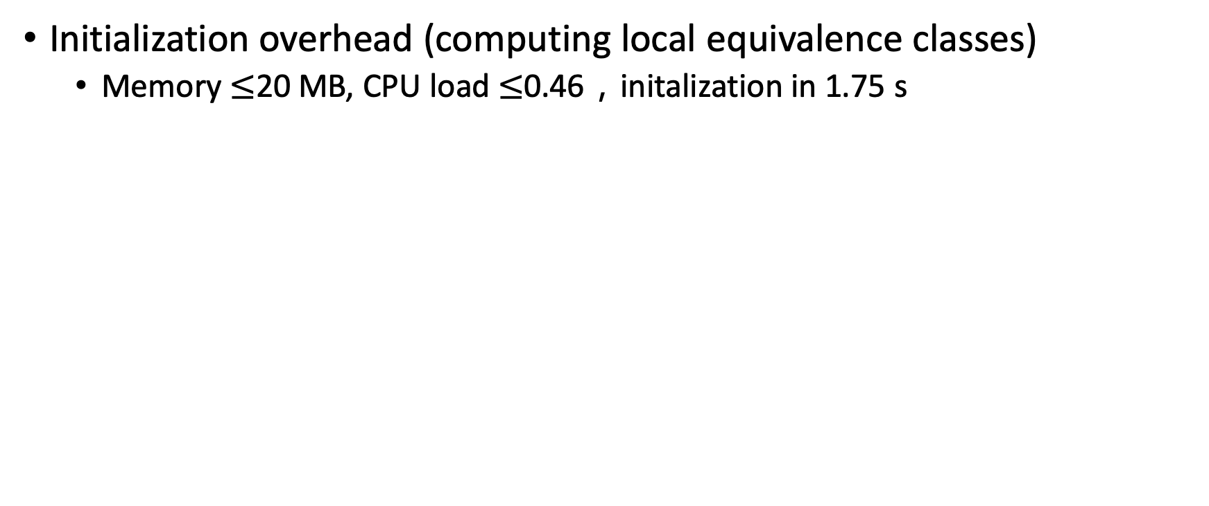
Experiment 4: Microbenchmark on Commodity Switches
Initialization overhead (computing local equivalence classes)
Memory $≤$20 MB, CPU load $≤$0.46，initalization in 1.75 s

Slide 23
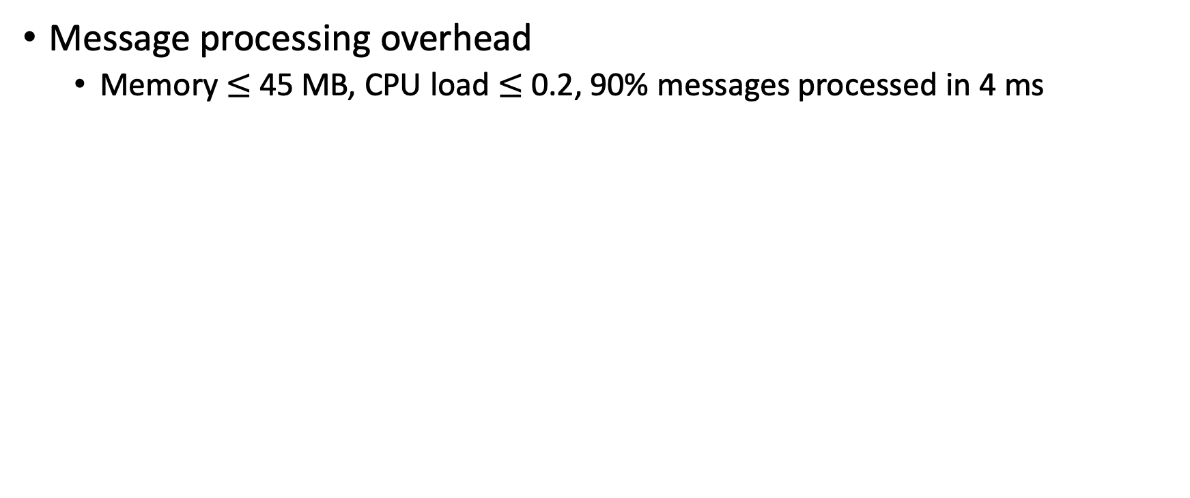
Experiment 4: Microbenchmark on Commodity Switches
Message processing overhead
Memory $≤$45 MB, CPU load $≤$ 0.2, 90% messages processed in 4 ms

Slide 24

Summary
For more information about Tulkun，reach out by email (qiaoxiang@xmu.edu.cn) or WeChat
Advantages of distributed DPV over centralized DPV:
better scalability, no single PoF, verification-as-a-service for vendors
Tulkun design elements:
declarative invariant specification language; planner via DVNet; on-device verifier and messaging protocol
Extensive evaluation using demo/testbed/simulation/microbenchmark: real-time, scalable in-network verification
Publications: ACM HotNets'22, ACM SIGCOMM'23
Open-source/demos：https://github.com/sonic-net/SONiC/pull/948
https://distributeddpchecking.com:8443/
http://distributeddpvdemo.tech/

Slide 25
What Happens Next: Automating the Full Cycle of Network Configuration Management
CPV
A-Graph [INFOCOM'21]
CCoral [WIP]
Verification
Interdomain
Configuration
Interdomain Synthesis
SDI [INFOCOM'20]
DPV
Coral [HotNets'22]
[SIGCOMM'23]
Flash [SIGCOMM'22]
Interdomain
Verification
IVeri [arXiv'21]
ICoral [WIP]
InCV [APNet'23]
Repair
Diagnosis
/Localization
Interdomain
Repair
IRepair [WIP]
Diagnosis / Repair
Scalpel [APNet'23]

Slide 26

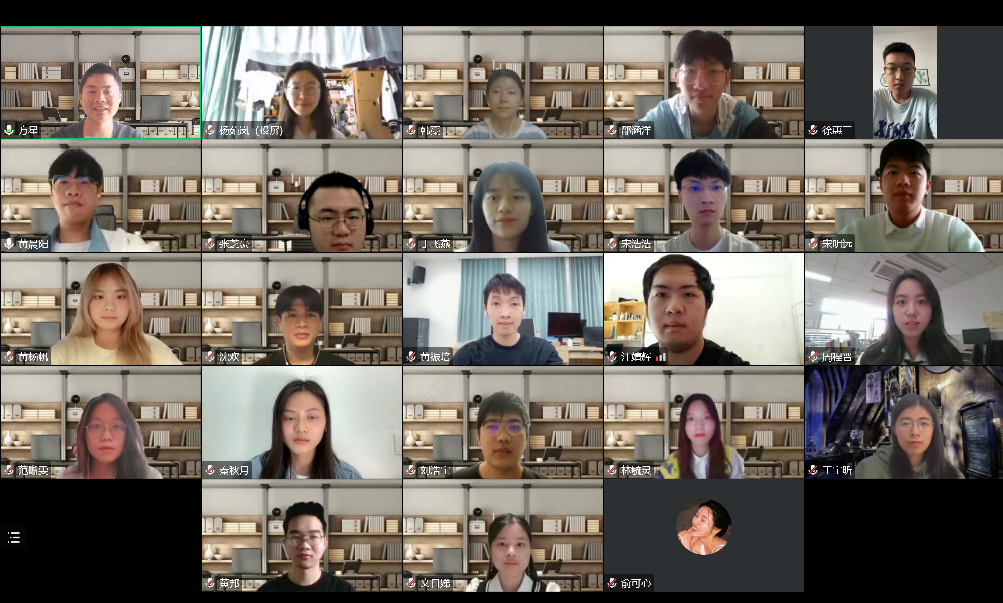
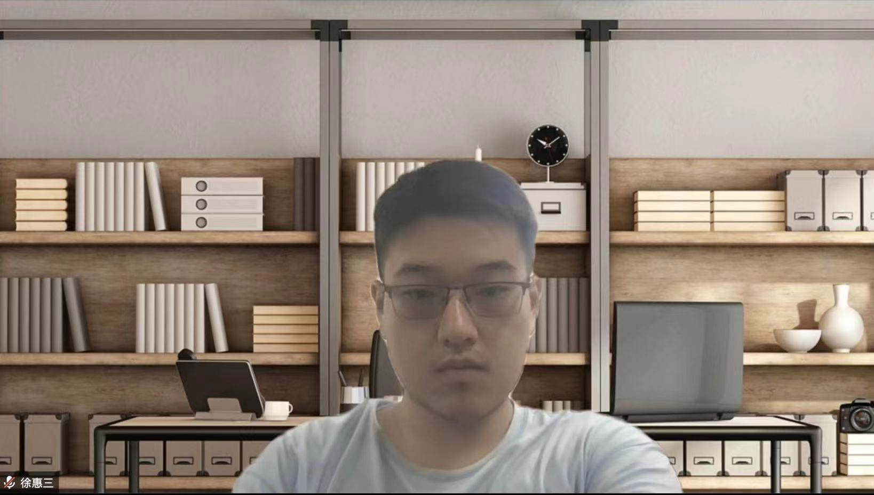



XMU SNGroup
SNGroup: sngroup.tech
Contact us: sngroup.xmu@outlook.com
Welcome to Visit Us!
Young team
6 PhD students
20 graduate students
4 undergraduates
Fun research
Network and formal methods
Programmable networks
High-performance networks
Interpretable intelligent networks

